Slide 1
Natural Language Processing
Lab 2
Text Preprocessing- Tokenization

Slide 2
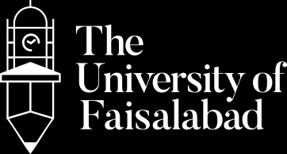



www.tuf.edu.pk
unioffaisalabad
Objectives:
Understand text preprocessing techniques
Implement various tokenization methods (word, sentence, character, n-gram) using Python.

Slide 3
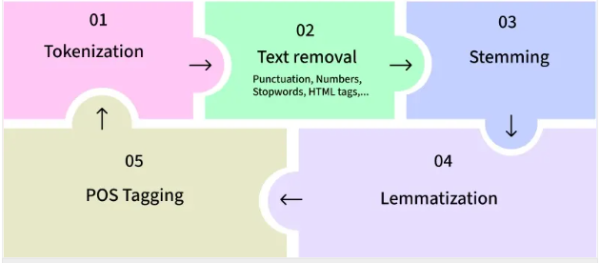
www.tuf.edu.pk
unioffaisalabad
Text Preprocessing in NLP
Text processing involves cleaning and preparing raw text data for further analysis.

Slide 4
www.tuf.edu.pk
unioffaisalabad
Tokenization:
Tokenization is a fundamental step in Natural Language Processing (NLP).
It involves dividing a Textual input into smaller units known as tokens.
These tokens can be in the form of words, characters, or sentences.

Slide 5
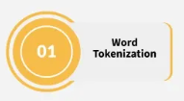
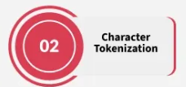
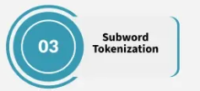
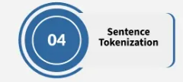
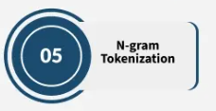
www.tuf.edu.pk
unioffaisalabad
Types of Tokenization:

Slide 6

www.tuf.edu.pk
unioffaisalabad
Word Tokenization:
from nltk import word_tokenize
text='hi everyone! this is my first program in python
for word tokenize. we are learning natural
language processing.'
word_tokens =word_tokenize(text)
print("Word Splitting-->",word_tokens)

Slide 7

www.tuf.edu.pk
unioffaisalabad
Sentence Tokenization:
from nltk import sent_tokenize
text='hi everyone! this is my first program in python
for sentence tokenize. we are learning natural
language processing.’
sent_tokens =sent_tokenize(text)
print(“Sentence Splitting-->",sent_tokens)

Slide 8
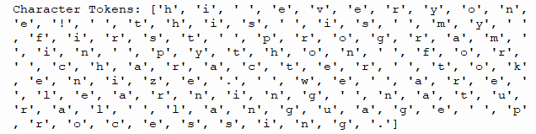
www.tuf.edu.pk
unioffaisalabad
Character Tokenization:
text='hi everyone! this is my first program in python
for character tokenize. we are learning natural
language processing.’
char_tokens =list(text)
print("Character Tokens:", char_tokens)

Slide 9

www.tuf.edu.pk
unioffaisalabad
Whitespace Tokenization:
text='hi everyone! this is my firstprogram inpython
for whitespace tokenize. we are learning natural
language processing.’
tokens_ws =text.split()
print("Whitespace Tokens:", tokens_ws)

Slide 10
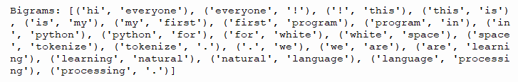
www.tuf.edu.pk
unioffaisalabad
Bigram Tokenization:
from nltk.util import ngrams
from nltk import word_tokenize
text='hi everyone! this is my first program in python
for whitespace tokenize. we are learning natural
language processing.’
tokens = word_tokenize(text)
bigrams = list(ngrams(tokens, 2))
print("Bigrams:", bigrams)

Slide 11
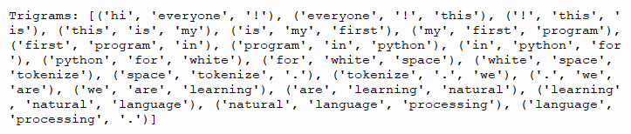
www.tuf.edu.pk
unioffaisalabad
Trigram Tokenization:
from nltk.util import ngrams
from nltk import word_tokenize
text='hi everyone! this is my first program in python
for whitespace tokenize. we are learning natural
language processing.’
tokens = word_tokenize(text)
trigrams = list(ngrams(tokens, 3))
print("Trigrams:", trigrams)

Slide 12
THANK YOU

